Slide 1

Sending Messages Using the LORA Network
Presented by Julian Grado

Slide 2
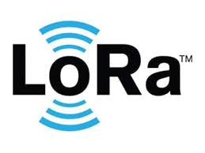
LORA Network:
A network using radio technology to transmit data
Low power wireless platform
Long Range
Used for energy management, natural resource reduction, pollution control, infrastructure efficiency, and disaster prevention
Can be easily plugged into infrastructure with low cost

Slide 3
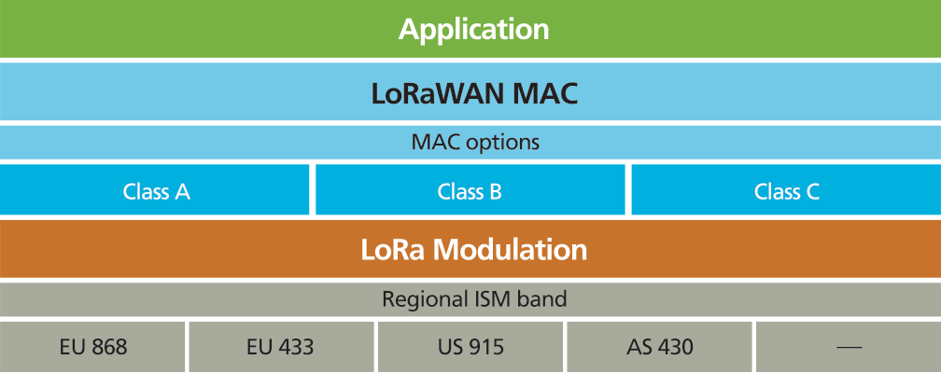
LORA and Battery Powered Devices
Connects to mobile devices
LORA can be used for Private, Public, or Hybrid Network
Greater range than cellular networks
The spectrum is regional, national, global networks

Slide 4
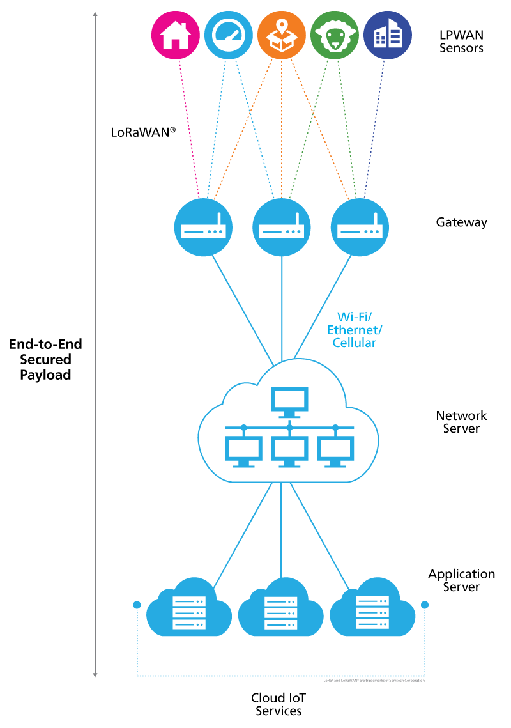
How it Works
Certain censors are made for each place the network possibly needs
A gateway is created
They create a network server
Then all data from devices transmit to the cloud and the cloud connects to the network server

Slide 5

Why use this?
It is very accessible, just plug in and connect
Low power consumption is needed to keep it running
Better than most cooperate company networks
Maintains communication even while the device is in motion
Supports millions of messages per base station
Supports Public Network Operators, and large markets

Slide 6
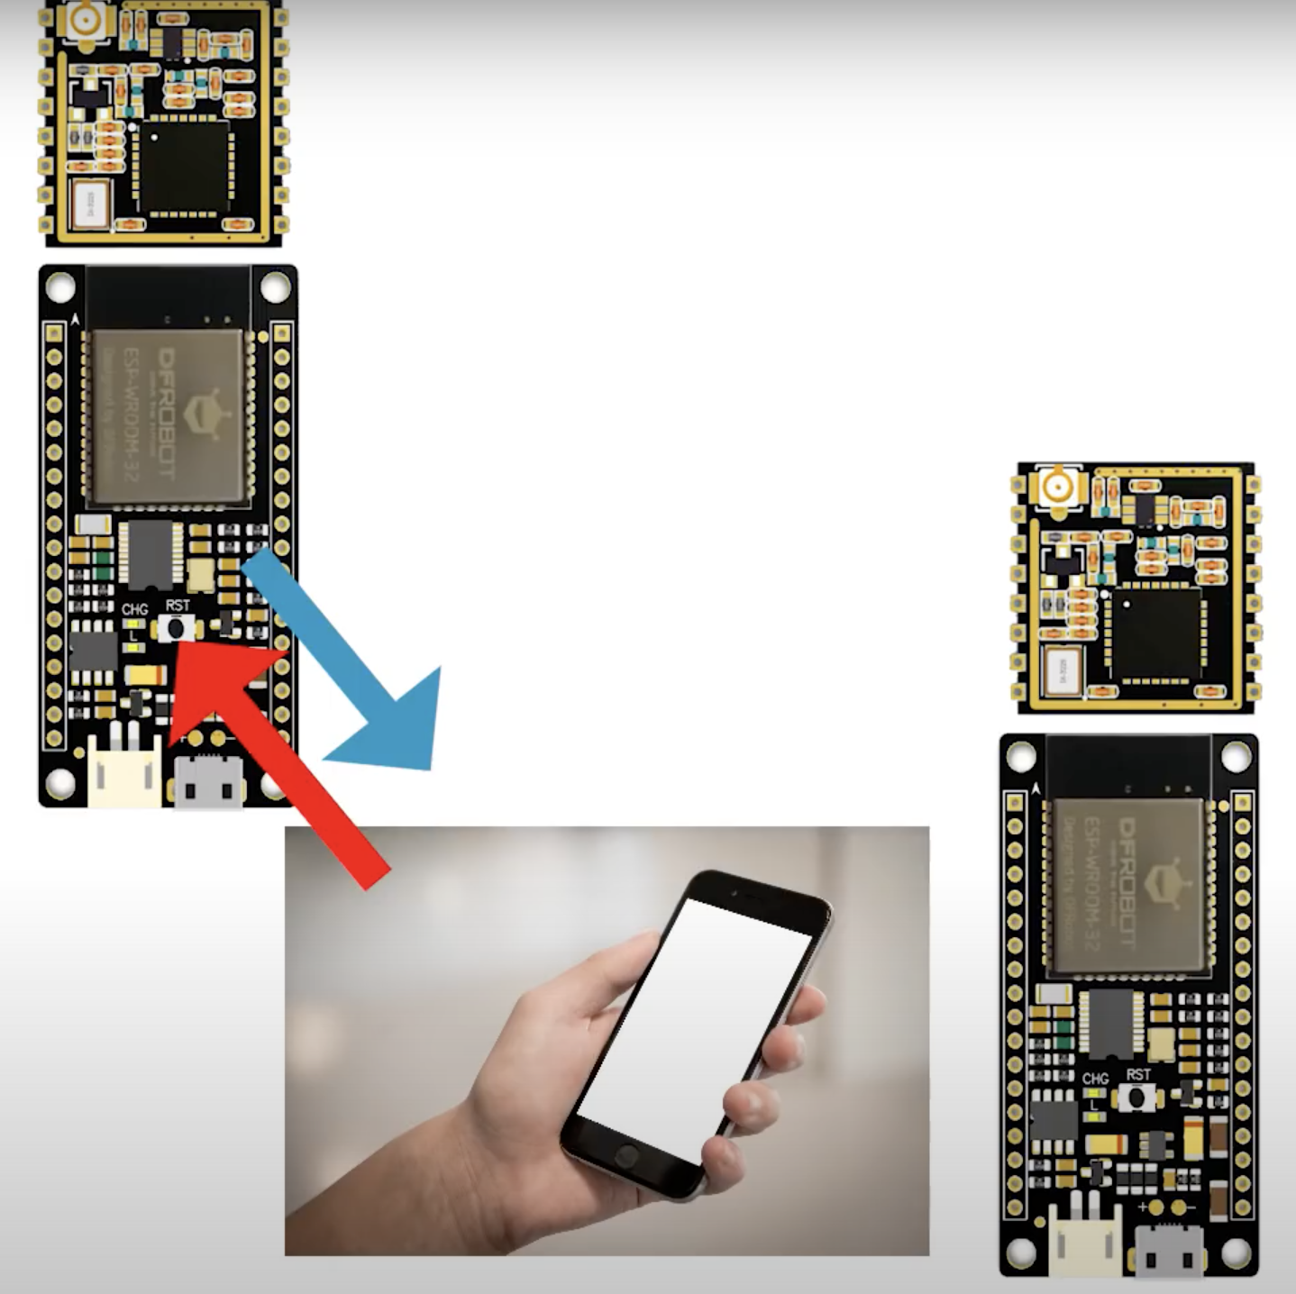
SMS
Under great conditions message can be sent up to 700 KL (436 Miles)
In Suburbs about 20 KL
You need to build multiple Devices with ASP and Lora Modules
Creates an access point
PC and Phone or PC with PC and connect to each of the networks
Once connected you may sent messages to each device as each one will act as a sender or receiver

Slide 7
Sources Used
https://www.youtube.com/watch?v=b_RPwtxtNdc
https://www.semtech.com/lora/what-is-lora

Slide 8
Thank You

